Slide 1



Cardiovascular Health Assessment
And Risk Prediction Model

Slide 2
Problem Statement
Visiting hospitals for regular check-ups it is almost always seen that they encourage people to get special check-ups to identify if they are at risk of heart diseases. Heart diseases have unfortunately become very common. It may be due to various reasons such as lifestyle, work pressure, lack of exercise, etc. In this project, we will be working on predicting the 10-year risk of Coronary Heart Disease (CHD). We are given a set of variables that impact heart diseases. These variables are related to demographic, past, and current medical history.
The dataset is from an ongoing cardiovascular study on residents of the town of Framingham, Massachusetts. The classification goal is to predict whether the patient has a 10-year risk of future coronary heart disease (CHD). The dataset provides the patients’ information. It include over 3390 records and 16 attributes Variables. Each attribute is a potential risk factor. There are both demographic, behavioural, and medical risk factors.

Slide 3
The risk of coronary heart disease (CHD) depends on various factors, including genetics, lifestyle choices, and medical history. Some common risk factors for CHD include:
High Blood Pressure: Hypertension can damage arteries over time, increasing the risk of CHD.
High Cholesterol: Elevated levels of LDL cholesterol (bad cholesterol) can lead to plaque buildup in the arteries, restricting blood flow to the heart.
Smoking: Tobacco use is a significant risk factor for CHD as it damages blood vessels and contributes to plaque buildup.
Diabetes: Individuals with diabetes are at a higher risk of developing CHD due to elevated blood sugar levels that can damage blood vessels.
Obesity: Being overweight or obese increases the risk of CHD as it often leads to conditions such as high blood pressure and diabetes.
Physical Inactivity: Lack of regular exercise can contribute to obesity and other risk factors for CHD.
Unhealthy Diet: Diets high in saturated and trans fats, cholesterol, sodium, and refined sugars increase the risk of CHD.
Family History: A family history of CHD can increase an individual's risk, suggesting a genetic predisposition to the condition.
Age and Gender: Risk of CHD increases with age, and men generally face a higher risk than premenopausal women. However, after menopause, women's risk catches up to men's.
Stress: Chronic stress can contribute to unhealthy behaviors such as overeating, smoking, or physical inactivity, which increase the risk of CHD.

Slide 4
1.Gathering a Data and Understanding the Variables
Load the Data: Depending on the format of the data (CSV, Excel, etc..) you'll use different methods to load it into your preferred data analysis tool (Python with libraries like Pandas, R, etc.).
Inspect the Data:
Shape of the Data: Check the dimensions of the dataset, typically represented as the number of rows (instances) and columns (features).
Data Types: Review the data types of each feature (numeric, categorical, datetime, etc.). This information helps in understanding the nature of the variables.
Statistical Summary: Compute summary statistics for numerical features, including mean, median, standard deviation, minimum, maximum, and quantiles. This provides an overview of the central tendency and dispersion of the data.
WHAT WE DONE
Import Libraries
Loading the Dataset
Exploring the Data(shapes, rows and column)
Dataset information
Missing values
Visualizing the Missing values
Know about the Dataset
Unique values

Slide 5
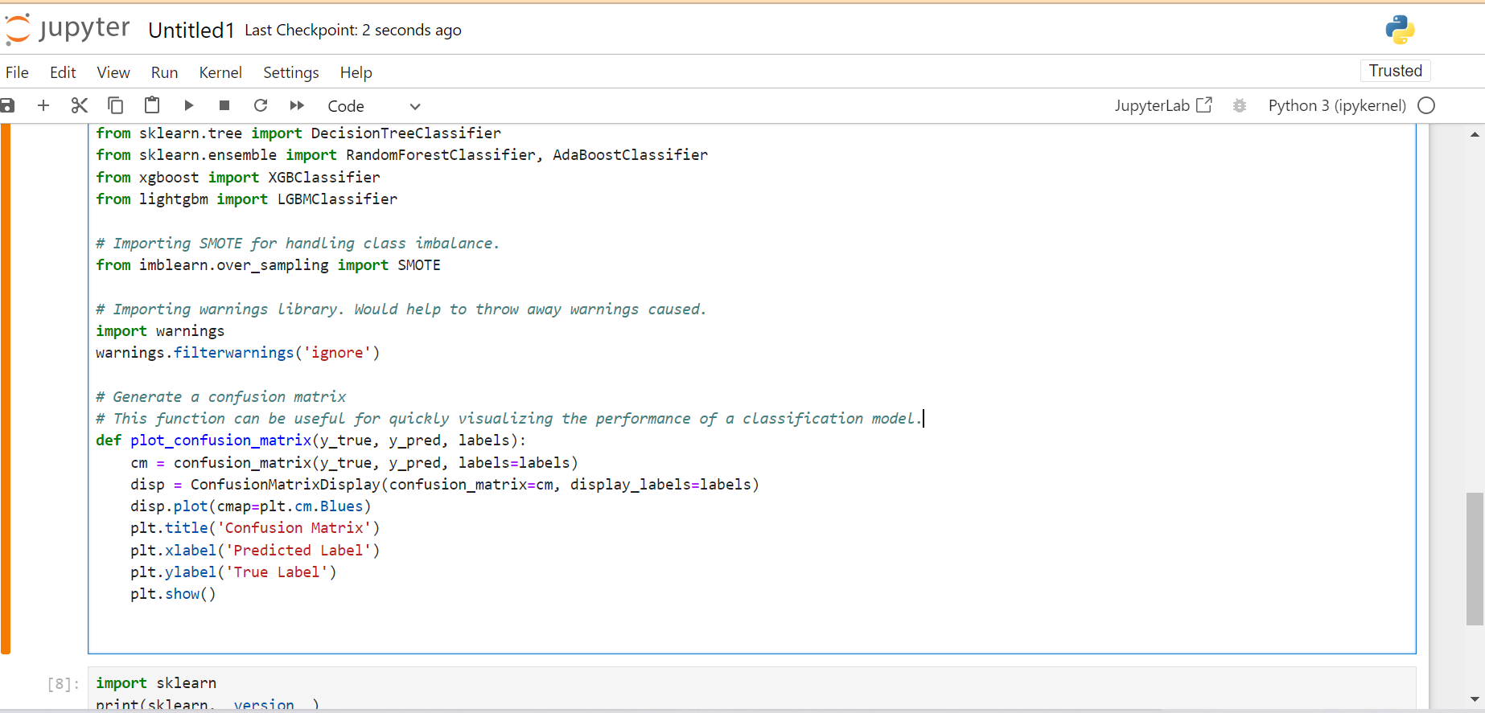
Import Libraries

Slide 6
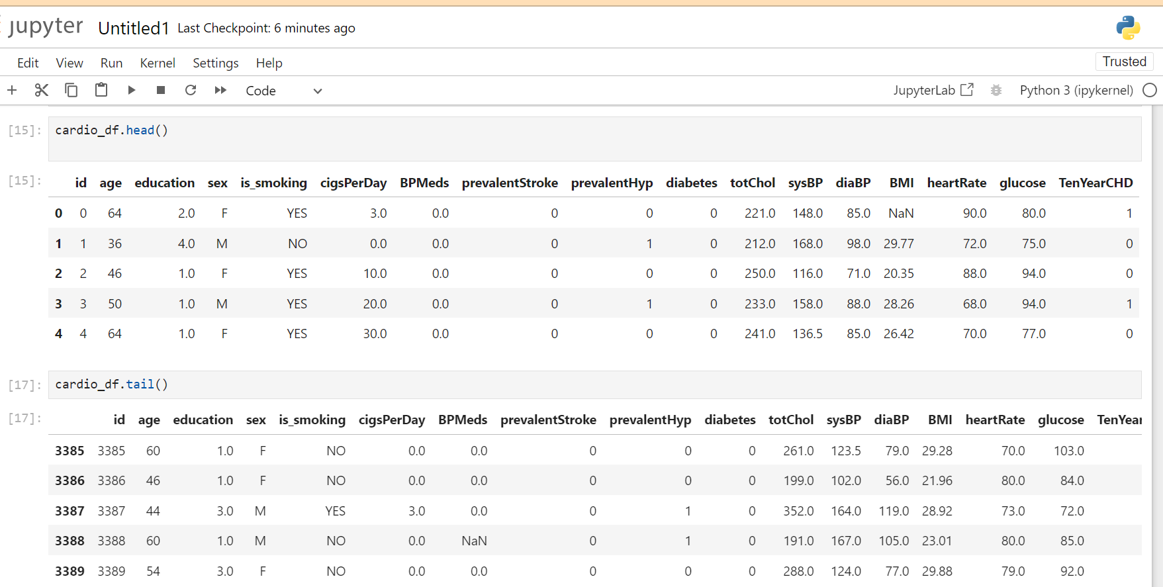
Data Exploration and gathering

Slide 7
Dataset
The data comes from an ongoing cardiovascular study of Framingham, Massachusetts, residents. The purpose of the classification is to determine whether the patient is at risk for coronary heart disease (CHD) in the ten years to come. The data about the patients is provided by the dataset. It incorporates more than 4,000 records and 15 ascribes.
A classification algorithm is a method of supervised learning that divides data into various classes by utilizing data training. Data or observations are used to train classification predictive modeling, and new observations are categorized into classes or groups.
There are 3390 rows and 17 columns in the dataset. In the 'education', 'cigsPerDay', 'BPMeds', 'totChol', 'BMI', 'heartRate', and 'glucose', there are missing values. The dataset does not contain any duplicate values.
A potential risk factor exists for each attribute. Demographic, behavioral, and medical risk factors are these characteristics.
First, we should try to understand the dataset through EDA, and then we can deal with null values later.

Slide 8
Dataset
The data set includes over 3300 records and 16 attributes, each of which is a potential risk factor, including demographic, behavioral, and medical risk factors.
Data Dictionary
Demographic:
• Sex: male or female ("M" or "F")
• Age: Age of the patient;(Continuous - Although the recorded ages have been truncated to whole numbers, the concept of age is continuous)
Education :
1 - Higher Secorndary, 2- Graduate, 3 - Post Graduate 4- Doctarte or PHD
Behavioural:
• is_smoking: whether or not the patient is a current smoker ("YES" or "NO")
• Cigs Per Day: the number of cigarettes that the person smoked on average in one day .(can be considered continuous as one can have any number of cigarettes, even half a cigarette.)

Slide 9
Medical (history):
• BP Meds: whether or not the patient was on blood pressure medication (Nominal)
• Prevalent Stroke: whether or not the patient had previously had a stroke (Nominal)
• Prevalent Hyp: whether or not the patient was hypertensive (Nominal)
• Diabetes: whether or not the patient had diabetes (Nominal)
Medical(current):
• Tot Chol: total cholesterol level (Continuous)
• Sys BP: systolic blood pressure (Continuous) • Dia BP: diastolic blood pressure (Continuous)
• BMI: Body Mass Index (Continuous)
• Heart Rate: heart rate(Continuous - In medical research, variables such as heart rate thought discrete, are considered continuous because of a large number of possible values.)
• Glucose: glucose level (Continuous)
Predict variable (desired target):
• 10-year risk of coronary heart disease CHD (binary: “1”, means “Yes”, “0” means “No”) – DV

Slide 10
2.Exploratory Data Analysis (EDA):
Exploratory Data Analysis (EDA)
EDA stands for Exploratory Data Analysis. It is a process of analyzing and understanding the data, which is an essential step in the data science process. The goal of EDA is to gain insights into the data, identify patterns, and discover relationships and trends. It is an iterative process that helps to identify outliers, missing values, and any other issues that may affect the analysis and modeling of the data.
WHAT WE DONE
1. Numeric and Categorical features
2. Univariate Analysis
2.1 Data Distribution of Numeric features
2.2 Outlier Analysis of Numeric features
2.3 Univariate Analysis of Categorical Features
3 Bivariate and Multivariate Analysis
3.1 Scatter plot between target varible wrt to age and heartRate
3.2 Regression plot between target variable and numerical features
3.3 Bivariate Analysis of Categorical Features

Slide 11
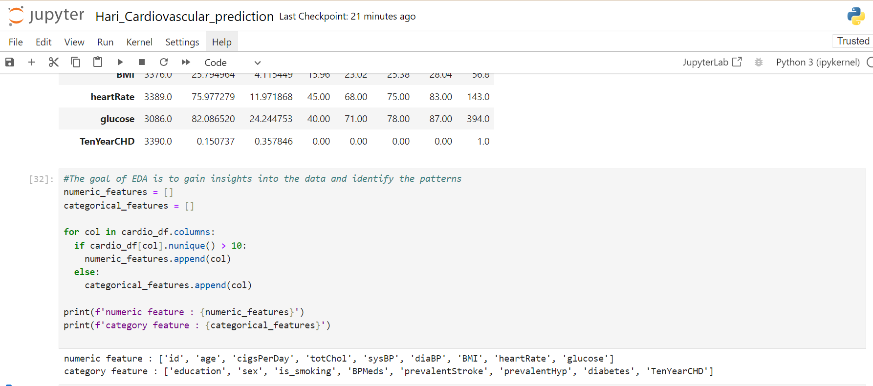
Exploratary Data anlaysis
Splitting features into Categorical and Numerical

Slide 12
3.Data Cleaning
Clean the dataset: Handle missing values by imputation or removal.
Encode categorical variables: Convert categorical variables like sex, education, and smoking status into numerical representations (e.g., one-hot encoding).
Standardize numerical features: Scale numerical features like age, cigarettes per day, total cholesterol, systolic/diastolic blood pressure, BMI, heart rate, and glucose to ensure they have a similar scale.
WHAT WE DONE
Duplicate Values
Missing Values
Handling Missing Values
Skewness
Treating Outliers

Slide 13
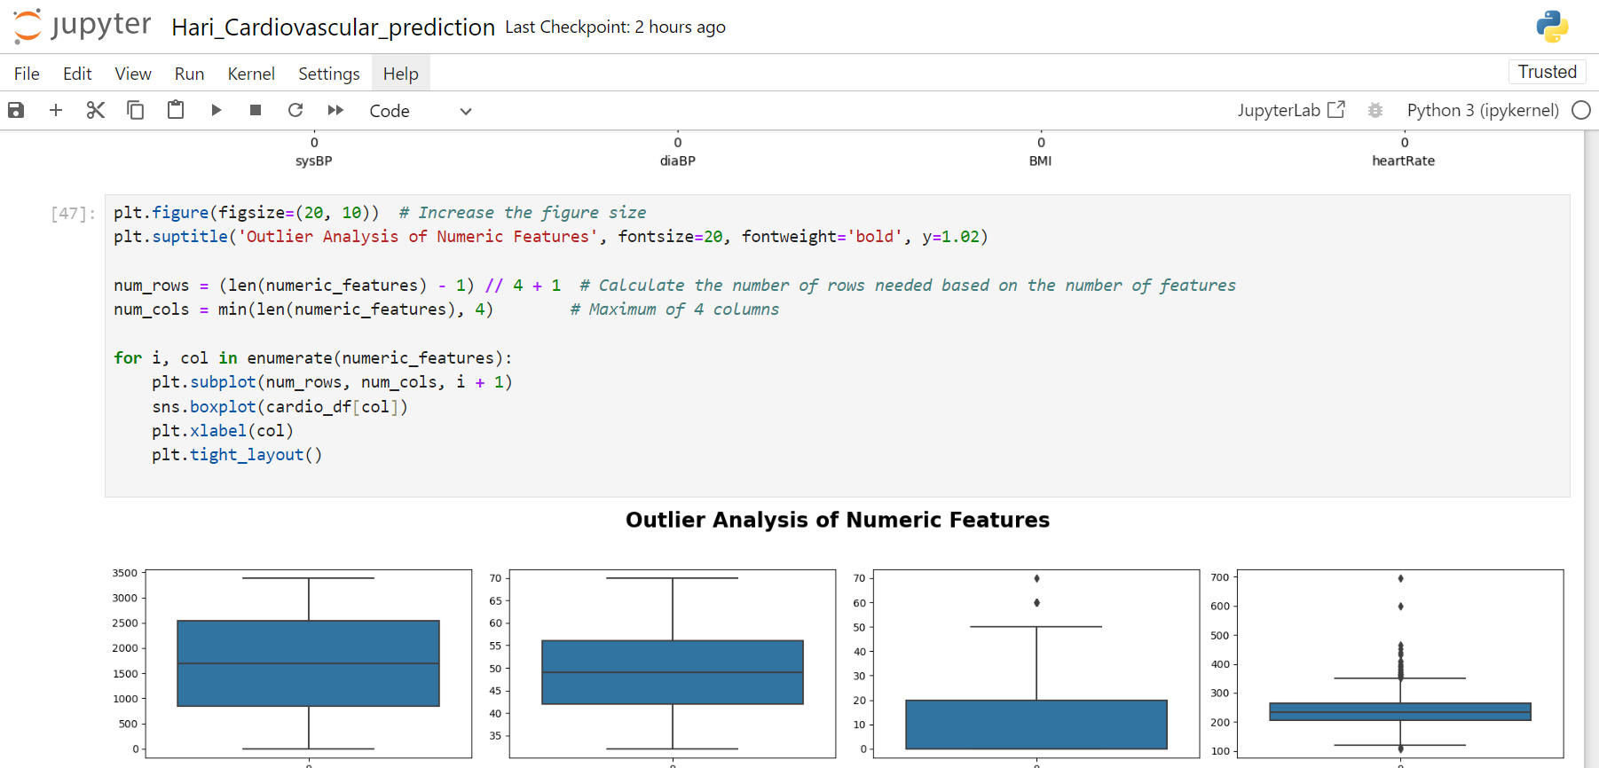
Outlier Analysis of Numeric features

Slide 14
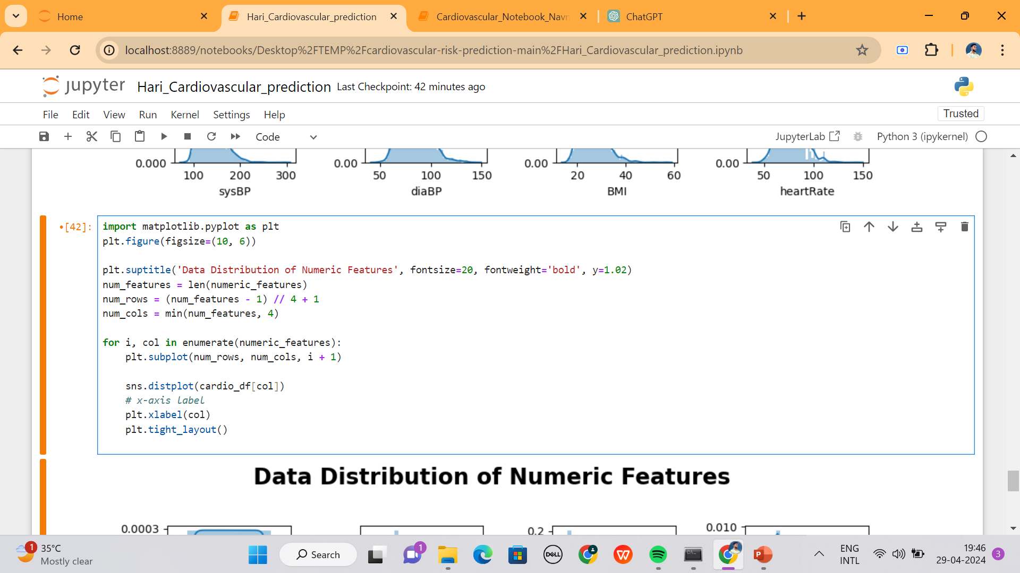
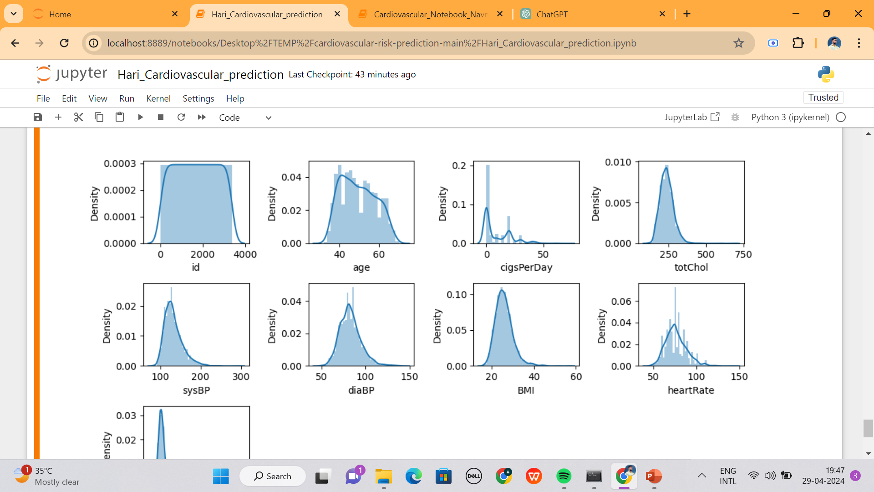
Univariate Analysis
Data Distribution of Numeric features

Slide 15
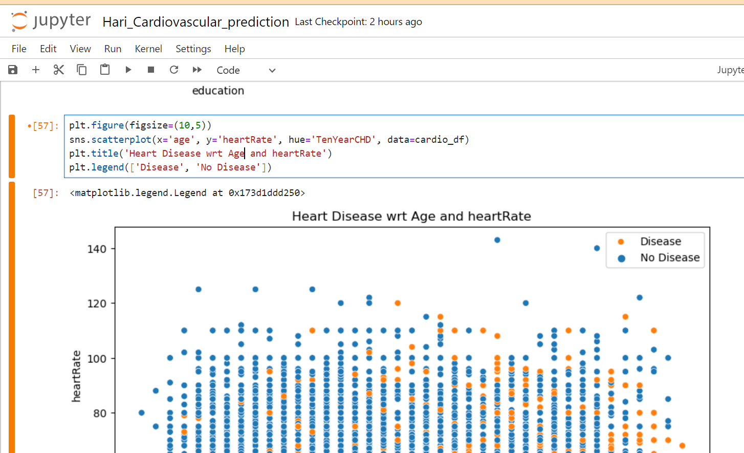
plotting graph to analyzed age with respect to heartrate which are having Disease or No Disease

Slide 16
4. Feature Engineering:
Feature engineering is a crucial aspect of machine learning (ML) model development. It involves transforming raw data into meaningful features that can improve the performance of ML models. Effective feature engineering can enhance model accuracy, interpretability, and generalization capabilities.
WHAT WE DONE
We did the encoding of categorical features. We used the correlation coefficient, chi-square test, information gain, and an extra tree classifier to select the most relevant features. SMOTE is used to address the class imbalance in the target variable.
1.Encoding
2.Feature Selection
3.Extra tree classifier
4.Chi-square Test
5.Information gain
6.Handling Imbalance Target Variable (We will use the Synthetic Minority Oversampling Technique (SMOTE) to resolve this issue.)

Slide 17
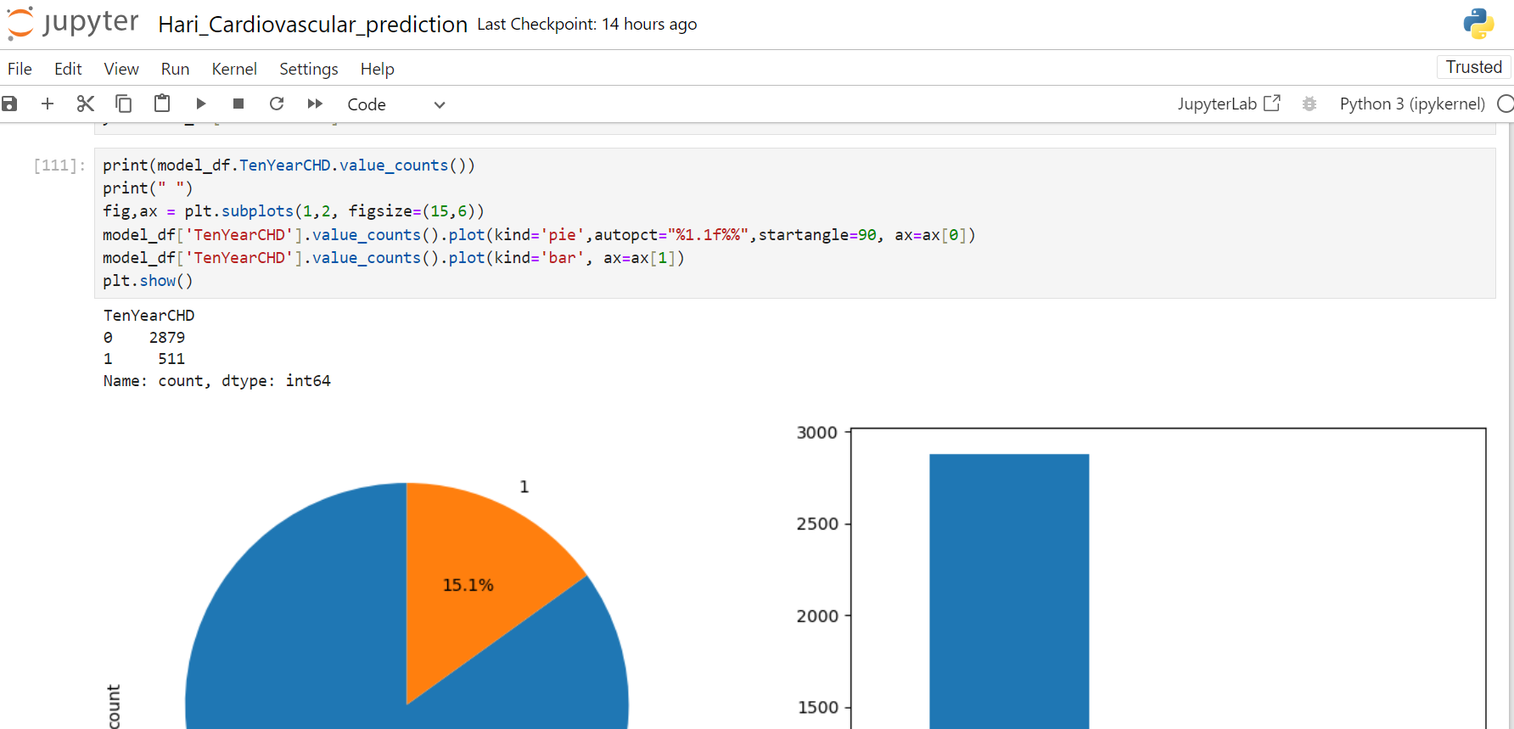
Handling Imbalance Target Variable
Checking if data is balanced or not

Slide 18
5.Model Building:
Split the dataset into training and testing sets.
Train the selected models on the training data.
Evaluate the trained models using evaluation metrics like accuracy, precision, recall, F1-score, and ROC-AUC.
WHAT WE DONE
1.Train Test Split
2.Scaling Data
3.Model Training

Slide 19
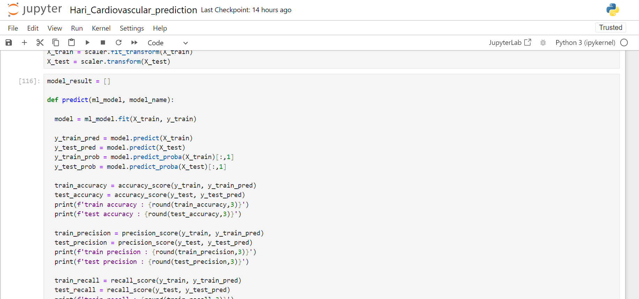
Model Training
empty list for appending performance metric score

Slide 20
Model Training
empty list for appending performance metric score

Slide 21
6.Model Evaluation and Implementation:
WHAT WE DONE
We scaled the features to bring down all of the values to a similar range. We pass the features to 8 different classification models. We also did hyperparameter tuning using RandomSearchCV and GridSearchCV.
Performance Evaluation: After passing it to various classification models and calculating the metrics, we choose a final model that can make better predictions. We evaluated different performance metrics but choose our final model using the f1 score and recall score.
Logistic Regression
Support Vector Machine
Decision Tree
K Nearest Neighbor
Random Forest
AdaBoost
XGBoost
LightGBM

Slide 22
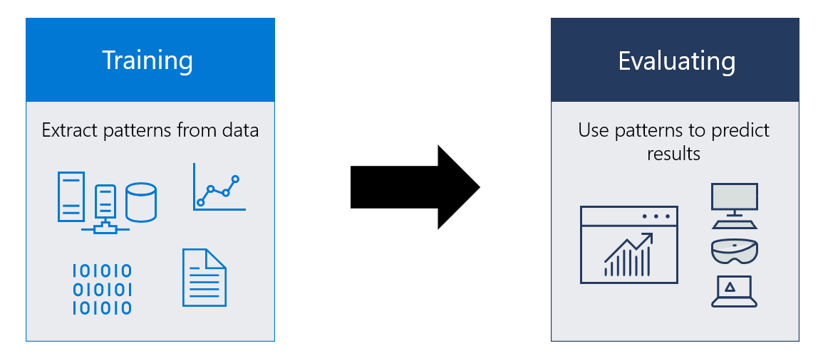
Model Evaluation and Implementation:
Various machine learning algorithms were trained and evaluated using multiple metrics, with a focus on recall and F1-score due to the dataset's class imbalance and importance in healthcare applications. LightGBM, XGBoost, RandomForestClassifier, and KNN emerged as top-performing models.
we can select the Final model as our KNN classifier due to its highest recall score. It is acceptable to classify a healthy individual as having a 10-year risk of coronary heart disease CHD (false positive) and to follow up with additional medical tests; however, it is categorically unacceptable to miss identifying a particular patient or to classify a particular patient as healthy (false negative).

Slide 23
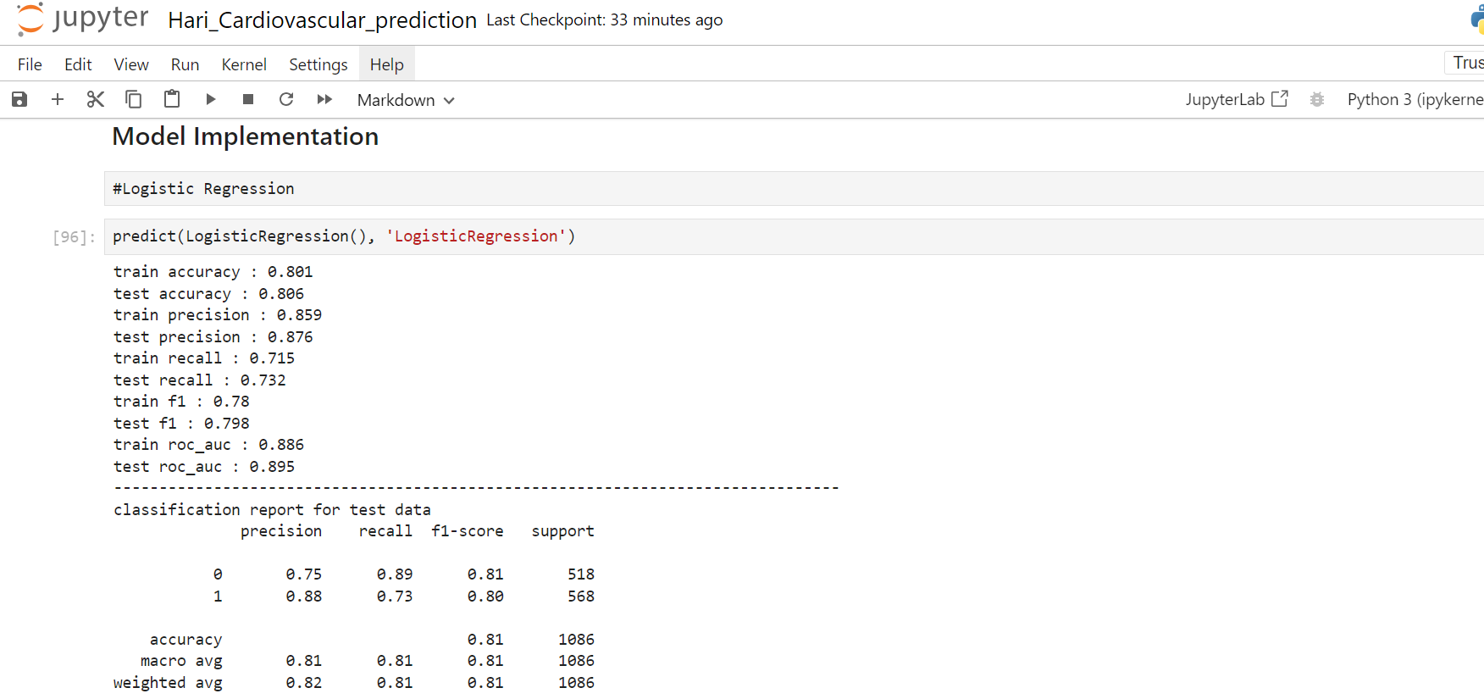
Model Implementation
Logistic Regression

Slide 24
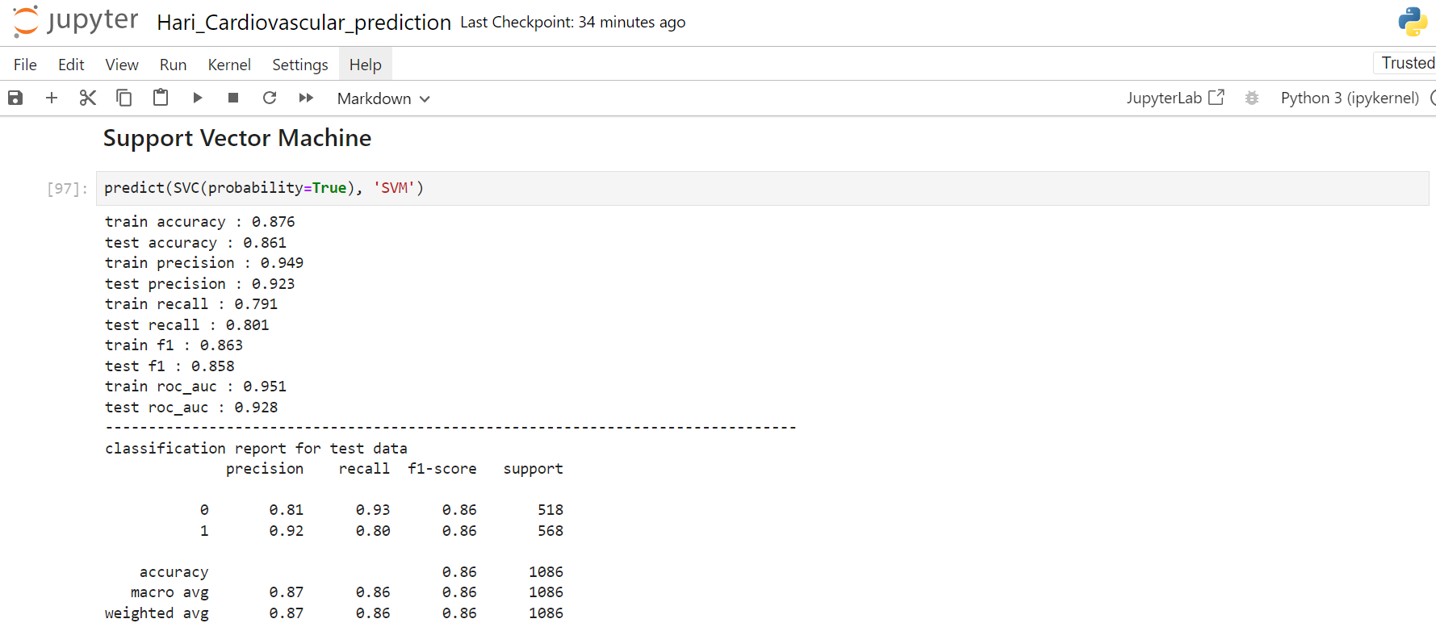
Model Implementation
Support Vector Machine

Slide 25
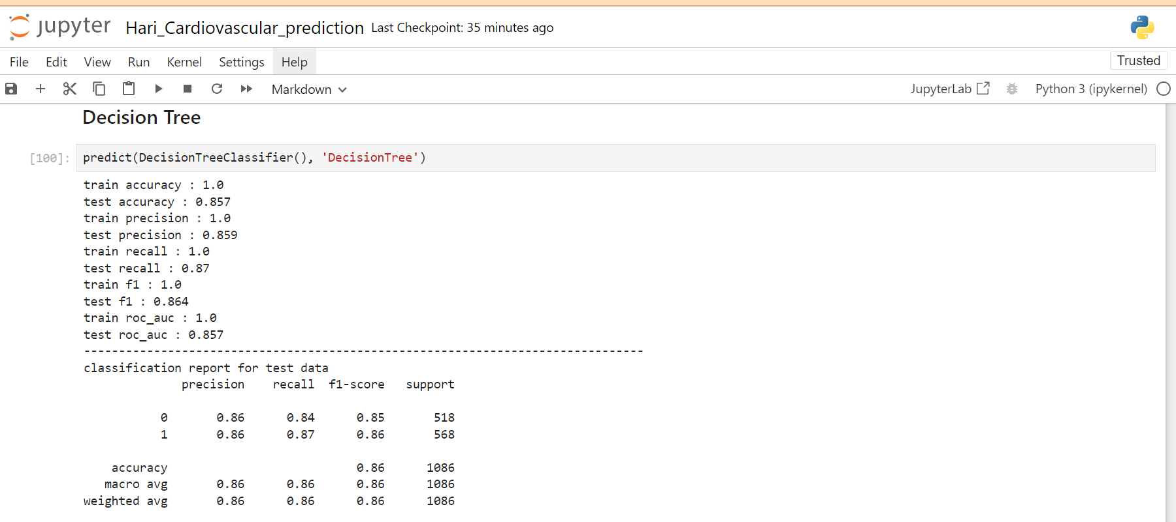
Model Implementation
Decision Tree

Slide 26
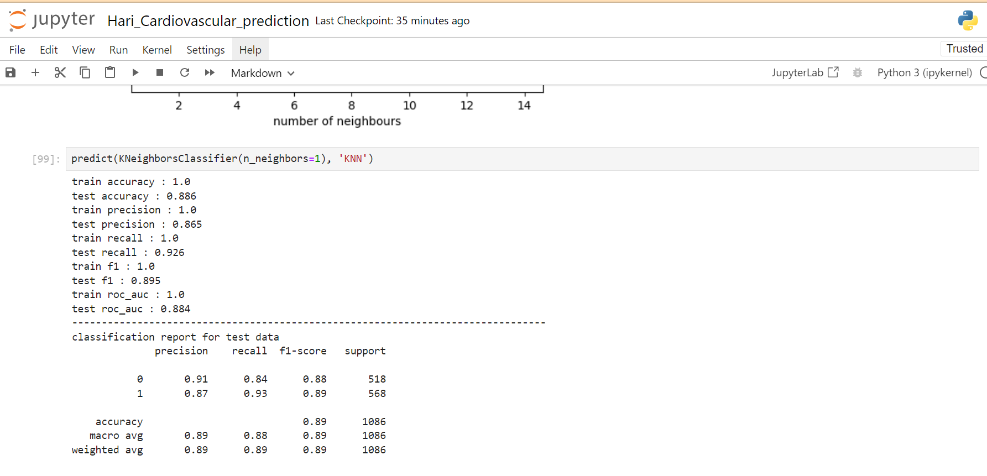
Model Implementation
KNN (K-Nearest Neighbours)

Slide 27
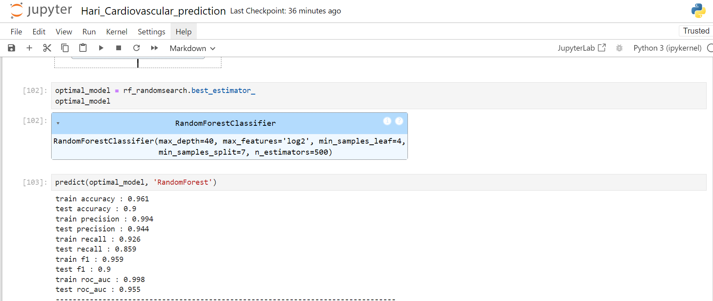
Model Implementation
Random Forest

Slide 28
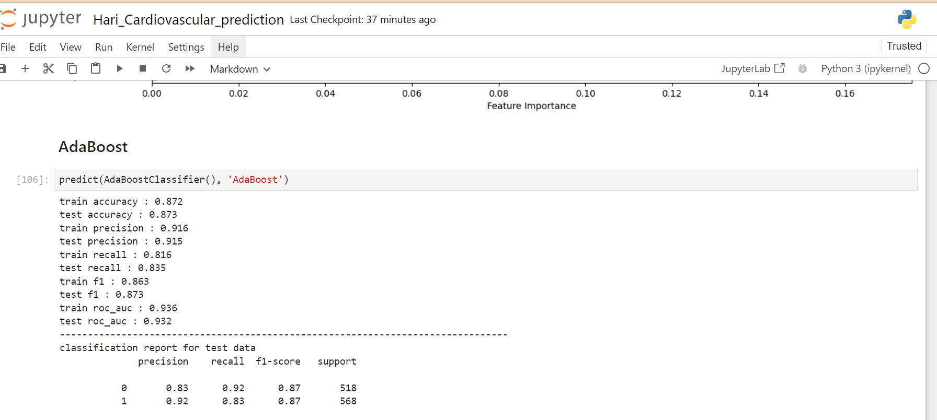
Model Implementation
Ada Boost

Slide 29
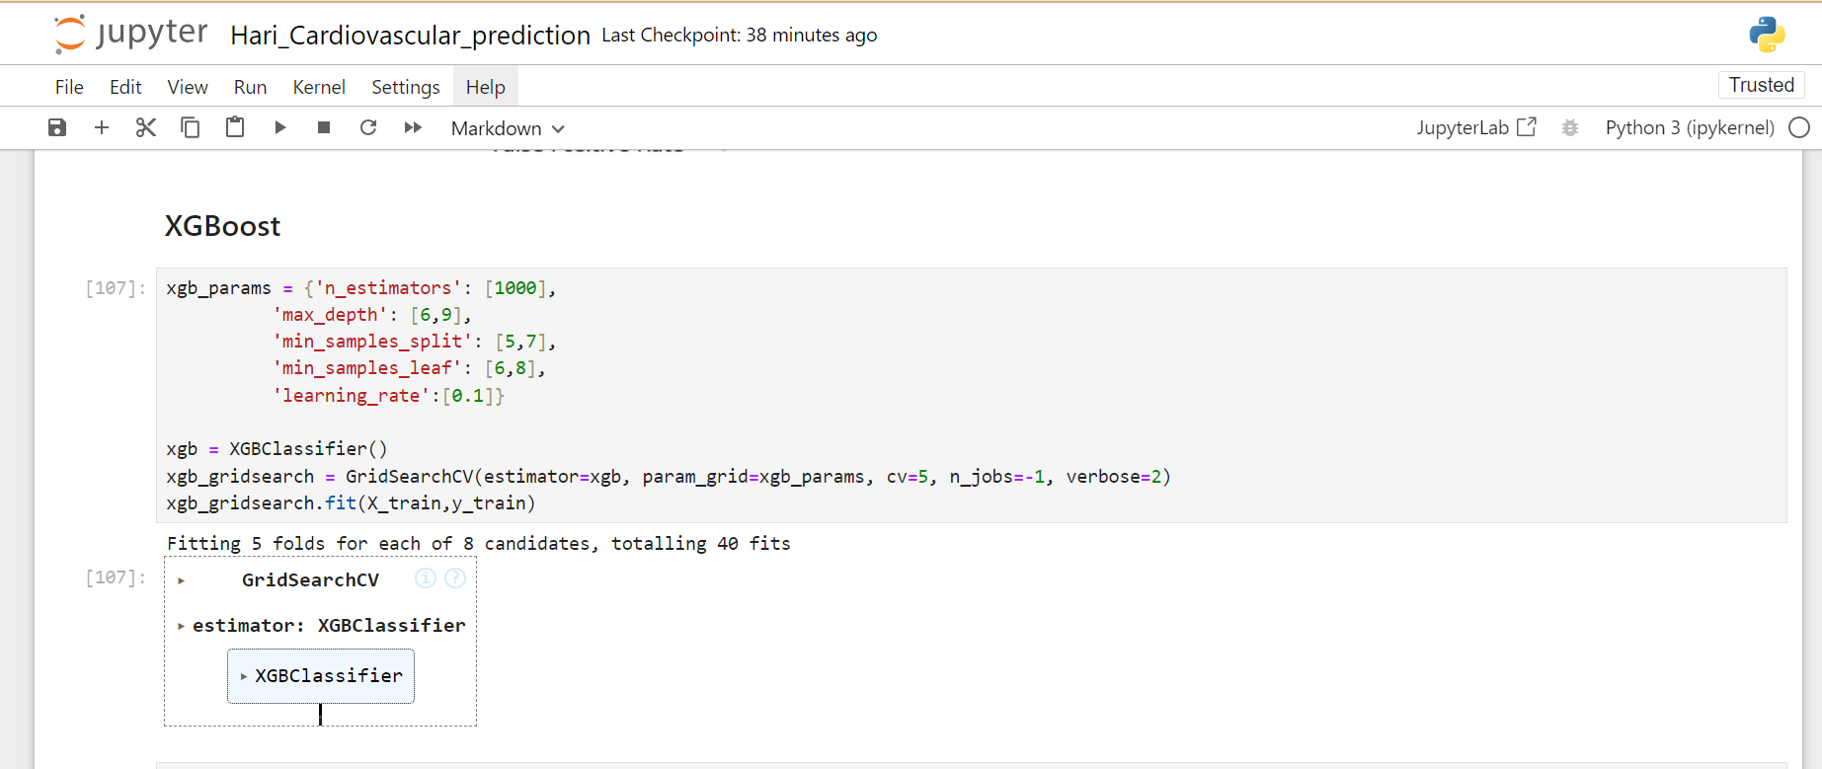
Model Implementation
XG Boost

Slide 30
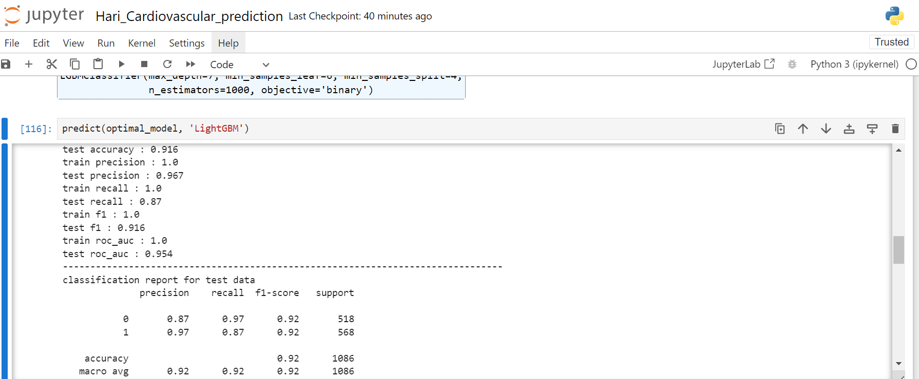
Model Implementation
Light Gradient Boosting
HyperParameter Tunning using GridSearchCV

Slide 31
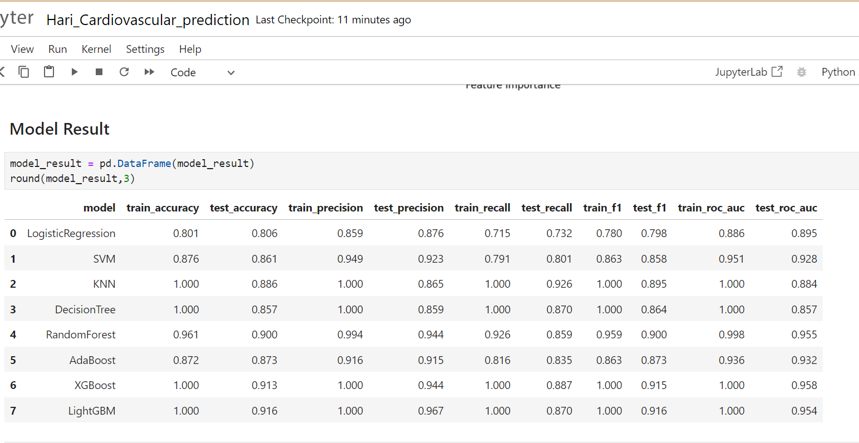
MODEL RESULT

Slide 32
RESULTS
When developing a machine learning model, it is generally recommended to track multiple metrics because each one highlights distinct aspects of model performance. We are, however, focusing more on the Recall score and F1 score because we are dealing with healthcare data and our data is unbalanced.
With an f1-score of 0.916 and a recall score of 0.870 on test data, we have noticed that LightGBM Classifier outperforms all other models. It is safe to say that the LightGBM Classifier is the best option for our issue if the f1-score is to be considered.
Our highest recall score, 0.926%, came from KNN.
The XGBoost and RandomForestClassifier tree-based algorithms also provided the best approach to achieving our goal. We were successful in achieving a respective f1-score of 0.915 and 0.900.

Slide 33
Conclusion
In Conclusion ,this project aimed to develop a predictive model for identifying the 10-year risk of coronary heart disease (CHD) based on demographic, behavioral, and medical factors.
Through meticulous data preparation, exploratory data analysis, and feature engineering, we gained insights into the relationships between various attributes and the target variable. By selecting appropriate machine learning algorithms, training them on the prepared dataset, and evaluating their performance using relevant metrics, we were able to develop a robust predictive model.
The model's performance was optimized through hyperparameter tuning and ensemble techniques, ensuring its accuracy and generalizability. Interpretation of the model provided valuable insights into the factors contributing most significantly to CHD risk prediction.
Continuous monitoring and updates to the model will ensure its effectiveness in real-world applications and contribute to improving public health outcomes.
In summary, this project demonstrates the power of data-driven approaches in healthcare, offering a promising tool for personalized risk assessment and proactive management of coronary heart disease.

Slide 34

Our rigorous data-driven approach has enabled the development of a highly accurate and clinically relevant predictive model for identifying the 10-year risk of coronary heart disease, contributing to improved patient outcomes and proactive healthcare management.
This conclusion succinctly encapsulates the key findings and decisions made throughout the project, emphasizing the clinical significance of the model selection criteria.

Slide 35


